Slide 1


II Project Presentation (KCS 851) (PCOcare)PCS-51
KIET Group of Institutions, Ghaziabad
(An ISO – 9001: 2008 Certified & ‘A+’ Grade accredited Institution by NAAC)
Guide Name: Prof. Pawan Kumar Pal
Project Members:
1. Aditi Singh 8B [2100290129001]
2. Pooja Kumari 8B [2000290120107]
3. Kirti Jayant 8B [2000290120087]

Slide 2
Problem Statement
The problem at hand is to develop an efficient and accurate machine-learning model for the early detection and prediction of PCOS from an optimal and minimal set of parameters.

Slide 3
Objectives
Efficient prediction of Poly-Cystic Ovarian Syndrome.
Helping young age girls gain knowledge about their menstrual health
Decreasing direct dependence on hospitals as the number of patients is increasing exponentially which contradicts available resources.
Providing tips to a healthy lifestyle and a proper diet chart for maintaining menstrual health, especially for women of reproductive age.

Slide 4
Technology Used
Machine Learning
Linear Regression
Convolutional Neural Network [for image classification]
Modules used
Flask
Tensorflow
Google collab
Python Libraries used for the model:
Numpy
matplotlib
scikit learn library
Frontend Web Development
HTML, CSS, JAVASCRIPT

Slide 5
Market Research
Market research on PCOS (Polycystic Ovary Syndrome) prediction and detection using machine learning techniques is an important area of study given the increasing prevalence of PCOS and the potential of machine learning in improving diagnosis and treatment. Conducting market research in this field involves analyzing the current market trends, identifying key players, understanding customer needs, and predicting future market demands.[keeping in mind the functional and non-functional requirements of the product]. We discovered may apps and websites related to period tracking and menstrual health but none related to the prediction of PCOS. Some most used apps and websites for tracking menstruation are:
1. MyFitnessPal
MyFitnessPal is a popular app that allows you to track your food intake, exercise, and weight
2. Flo
Flo is a period tracking app that can also help you manage your PCOS symptoms. It allows you to track your menstrual cycle, ovulation, and symptoms like acne and weight gain.

Slide 6
Why PCOcare?
Creating a PCOS prediction system serves several valuable purposes in the context of healthcare and public health:
Early Intervention: Predictive systems can identify individuals at risk of developing PCOS before symptoms become severe. Early intervention can help prevent or manage the condition effectively, reducing the risk of complications.
Preventing Complications: PCOS is associated with various health complications such as diabetes, heart disease, and endometrial cancer. By predicting PCOS early, healthcare providers can implement measures to reduce the risk of these complications.
Fertility Planning: For individuals trying to conceive, early prediction of PCOS can facilitate appropriate fertility treatments, increasing the chances of successful pregnancies.
Healthcare Resource Optimization: Predictive systems can help healthcare providers allocate resources more efficiently. By identifying high-risk individuals, medical professionals can prioritize screenings and interventions, ensuring that those who need care the most receive it promptly.

Slide 7
5. Public Health Awareness: Predictive systems can contribute to raising awareness about PCOS. By highlighting the risk factors and early signs, more people might seek medical advice, leading to earlier diagnosis and better management.
6. Research and Development: PCOS prediction systems generate valuable data that can be used in research. Analyzing this data can enhance our understanding of PCOS, leading to improved diagnostic techniques, treatments, and potentially preventive measures.
7. Cost-Efficiency: Early intervention and prevention are generally more cost-effective than treating complications. By predicting PCOS and managing it early, healthcare systems can potentially reduce long-term healthcare costs associated with treating severe complications.
In essence, a PCOS prediction system can significantly improve individual outcomes, enhance healthcare efficiency, advance medical research, and contribute to overall public health by addressing this prevalent and impactful condition.

Slide 8
Technologies
Numpy: It is a fundamental library in the Python programming language for numerical and mathematical computations
Pandas: Pandas is an open-source Python library designed for data manipulation and analysis for working with structured data.
Matplotlib: It provides a flexible and highly customizable interface for creating a wide variety of charts, graphs, plots, and other visual representations of data
Scikit Learn: It provides a comprehensive set of tools and algorithms for various machine learning tasks, including classification, regression, clustering, dimensionality reduction, model selection, and more.
Tensor Flow:It is designed to be user-friendly, modular, and highly extensible, making it a popular choice for building and training deep neural networks.

Slide 9
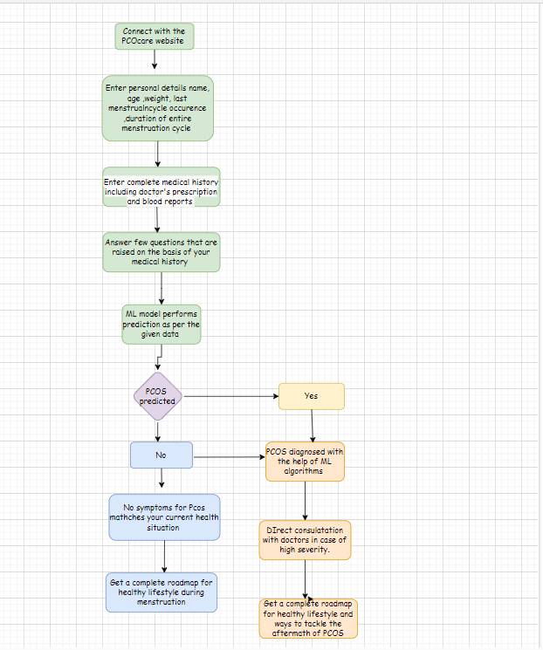
Workflow Diagram

Slide 10
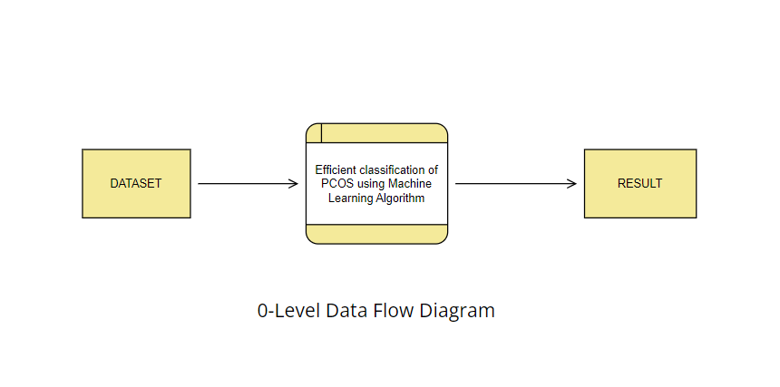
Data Flow Diagram

Slide 11
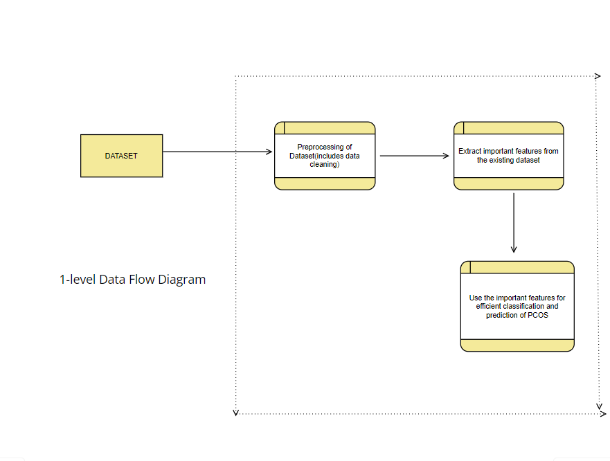
Data Flow Diagram
PCOS prediction

Slide 12
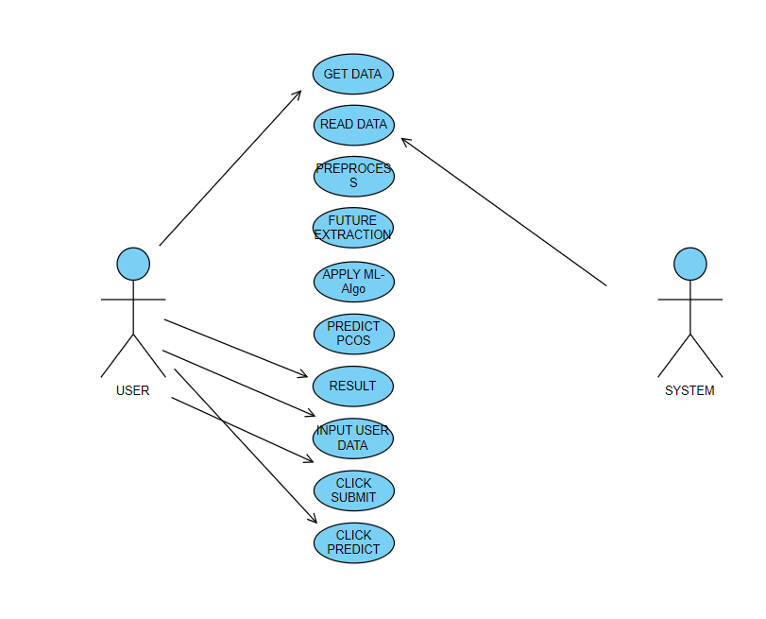
Use Case Diagram

Slide 13
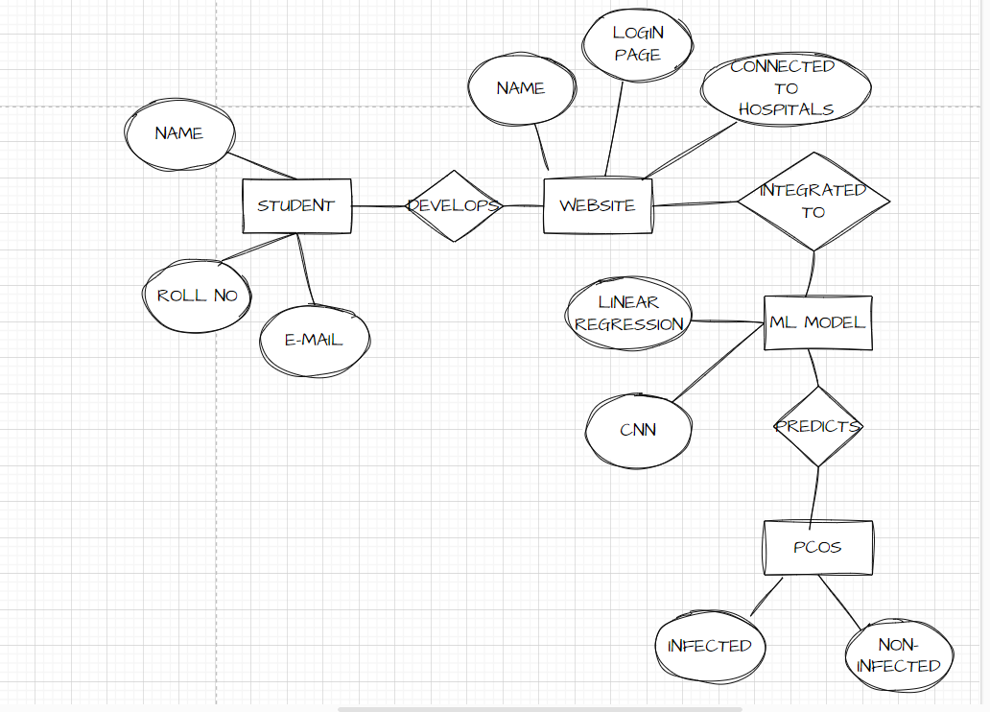
ER Diagram

Slide 14
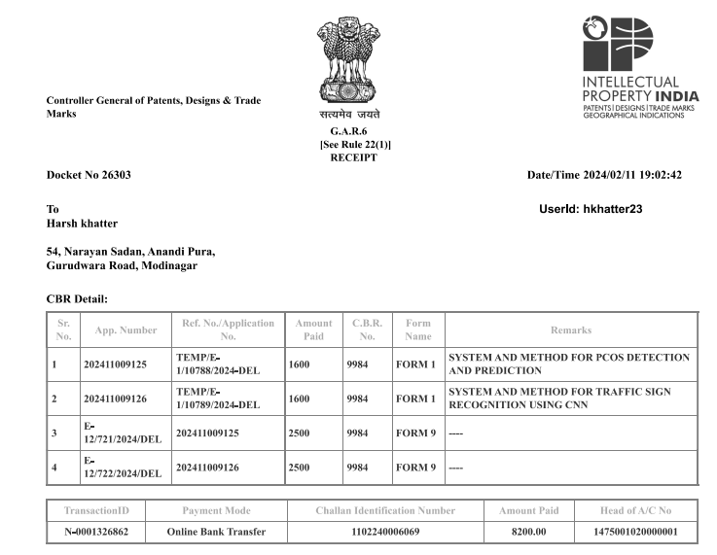
Patent Status
Submitted to Project Guide -6th of September 2023
Patent Published – 12th February 2024

Slide 15
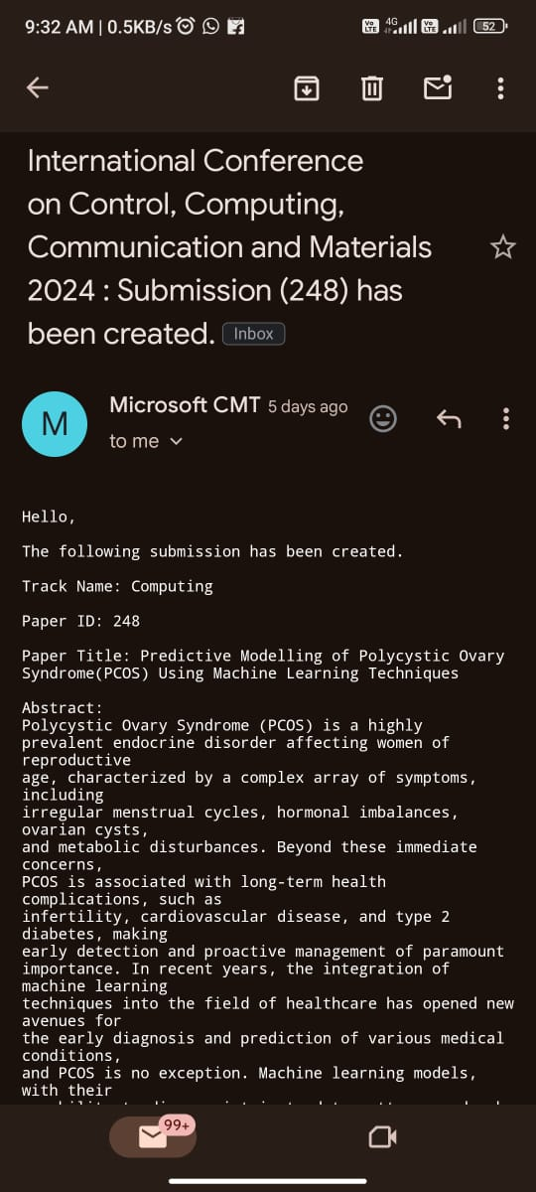
Research Paper Status
Draft completion status: 100%
Draft approved by project guide.
Submitted to United College
of engineering and Research.

Slide 16
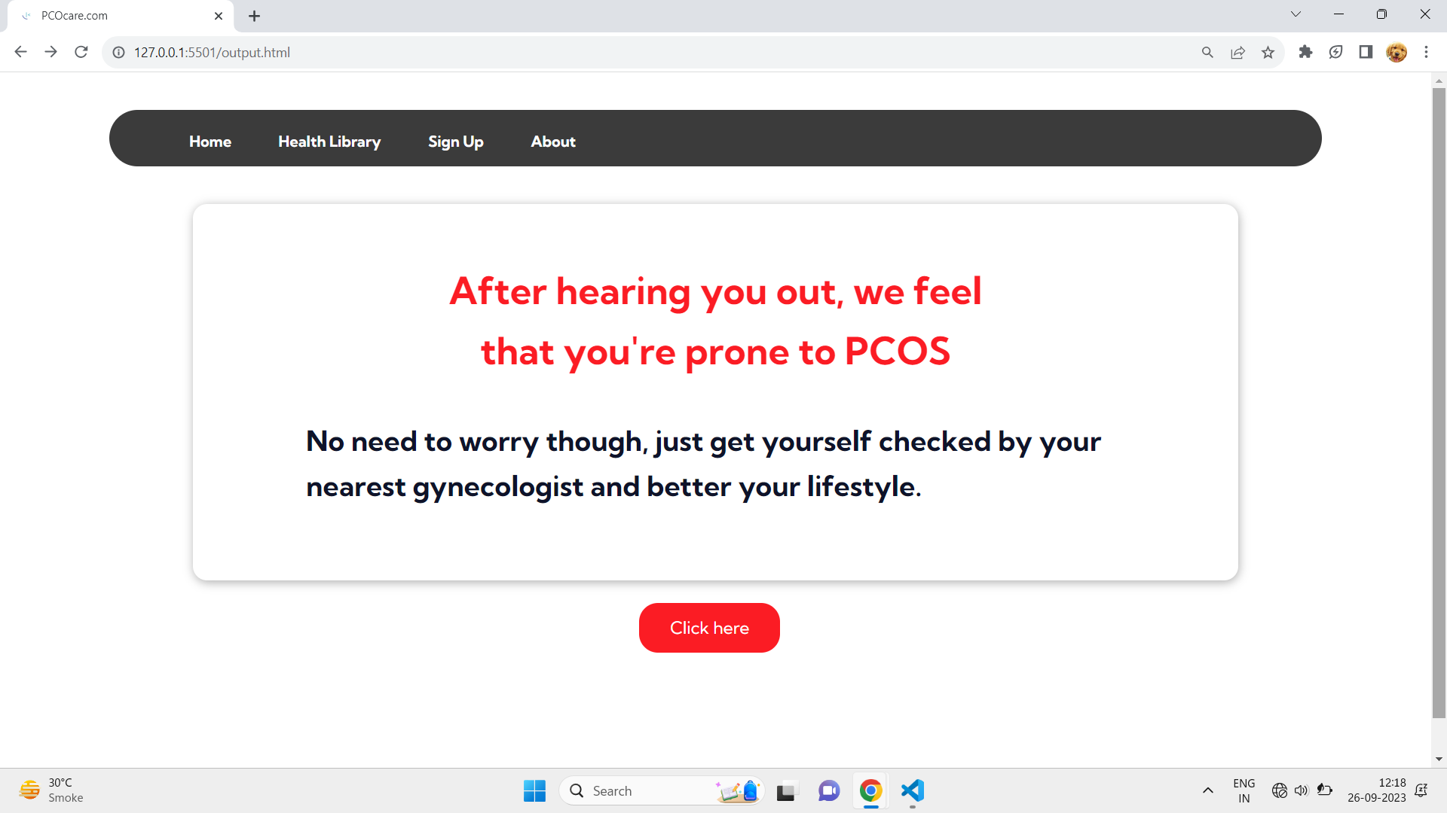
Project Status
Frontend complete, ML code complete
Integration Using Flask
Expected output:

Slide 17
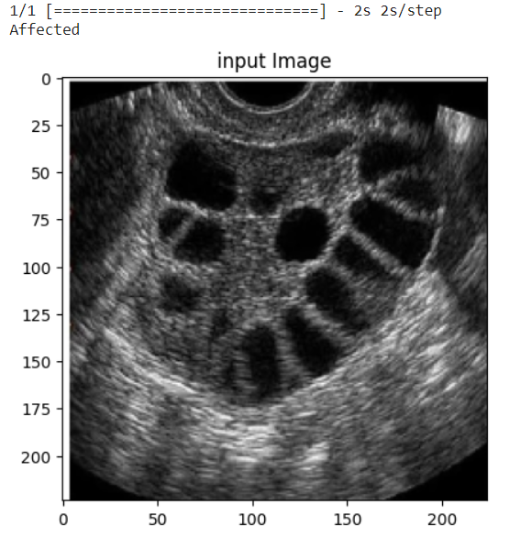
Present Output

Slide 18
Testing Report
Drive Link: Report Link
https://docs.google.com/document/d/19_CweffYDO0TowO4boM6nYNM2UjqQAKP/edit?usp=sharing&ouid=118419814779100673506&rtpof=true&sd=true

Slide 19
References
[1] Palak Mehrotra, Jyotirmoy, Chatterjee, Chandan Chakraborty, “Automated Screening of Polycystic Ovary Syndrome using Machine Learning Techniques”, IEEE, 2012.
[2] Bedy Purnama, Untari Novia Wisesti, Adiwijaya, Fhira Nhita, Andini Gayatri, Titik Mutiah, “A Classification of Polycystic Ovary Syndrome Based on Follicle Detection of Ultrasound Images, 2015 3rd International Conference on Information and Communication Technology (ICoICT).
[3] Amsy Denny, Anita Raj, Ashi Ashok, Maneesh Ram C, Remya George, “I-HOPE: Detection and Prediction System for Polycystic Ovary Syndrome (PCOS) Using Machine Learning Techniques”, 2019 IEEE Region 10 Conference (TENCON 2019).
[4]. Image Segmentation for detecting Polycystic Ovarian Disease using Deep Neural Networks Palvi Soni1*, Sheveta Vashisht2 Research Paper Vol. -7, Issue-3, March 2019
[5]. Detection of Polycystic Ovary Syndrome (PCOS) Using MachineLearning Algorithms Dana Hdaib, Dana Hdaib, Hiam Alquran, Wan Azani Mustafa, Wan Azani Mustafa, Ahmed Alkhayyat 5 th International Conference on Engineering Technology and its applications 2022- (5thIICETA2022)
[6]. Automated Detection of Polycystic Ovary Syndrome Using Machine Learning Techniques Yasmine A. Abu Adla, Dalia G. Raydan, Mohammad-ZaferJ. Charaf, Roua A. Saad, Jad Nasreddine, Mohammad O. Diab Conference Paper October 2021

